Slide 1
Polymorphism
The word ‘polymorphism’ literally means ‘a state of having many shapes’ or ‘the capacity to take on different forms’. When applied to object oriented programming languages like Java, it describes a language’s ability to process objects of various types and classes through a single, uniform interface.
Polymorphism
Compile time polymorphism
(static binding or method overloading)
Runtime polymorphism
(dynamic binding or method overriding)

Slide 2
Polymorphism
An important example of polymorphism is how a parent class refers to a child class object. In fact, any object that satisfies more than one IS-A relationship is polymorphic in nature. For instance, let’s consider a class Animal and let Cat be a subclass of Animal. So, any cat IS animal. Here, Cat satisfies the IS-A relationship for its own type as well as its super class Animal.
Class Animal
Super Class
Any cat IS animal. Here, Cat satisfies the IS-A relationship for its own type as well as its super class Animal.
Sub Class
Class Cat
Note: It’s also legal to say every object in Java is polymorphic in nature, as each one passes an IS-A test for itself and also for Object class.

Slide 3
Polymorphism
Static Polymorphism
In Java, static polymorphism is achieved through method overloading. Method overloading means there are several methods present in a class having the same name but different types/order/number of parameters.
At compile time, Java knows which method to invoke by checking the method signatures. So, this is called compile time polymorphism or static binding.

Slide 4
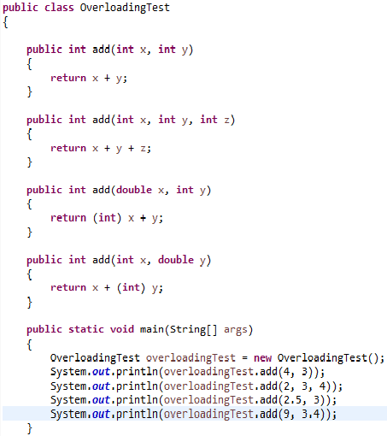
Polymorphism
Static Polymorphism Example
In this example, there are four versions of add methods. The first method takes two parameters while the second one takes three. For the third and fourth methods there is a change of order of parameters.
The compiler looks at the method signature and decides which method to invoke for a particular method call at compile time.

Slide 5
Polymorphism
Dynamic Polymorphism
Suppose a sub class overrides a particular method of the super class. Let’s say, in the program we create an object of the subclass and assign it to the super class reference. Now, if we call the overridden method on the super class reference then the sub class version of the method will be called.

Slide 6
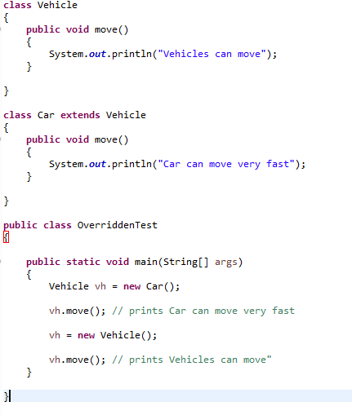
Polymorphism
Dynamic Polymorphism Example
It should be noted that in the first call to move(), the reference type is Vehicle and the object being referenced is Car. So, when a call to move() is made, Java waits until runtime to determine which object is actually being pointed to by the reference. In this case, the object is of the class Car. So, the move() method of Car class will be called. In the second call to move(), the object is of the class Vehicle. So, the move() method of Vehicle will be called.
As the method to call is determined at runtime, this is called dynamic binding or late binding.

